Slide 1

Get to Know Us
Fast, friendly, and fully functional, our network of independent dispatchers are well
renowned throughout the United States, when it comes to finding the right freight
for your needs. Our team is up for every challenge, with the skill and experience our
clients have come to expect. We always stand behind our work, with customer
satisfaction being our #1 priority. Contact us to learn more about our incredible network
of dispatchers and how they can help you!

Slide 2


Owner Operators
We're Always Here For You
Learn About Our Carrier Agreement and Profile
Hinton Dispatching and Associates is
Built By Owner Operators For Owner Operators!
So we understand, "Every carrier is unique in their load pricing needs"
Our "Network of Dispatcher Associates" will cater their load search to your pricing requirements.
In other words, if you need $2.50 CPM to run a load, our dispatchers will only look for & contact you
with offers of $2.50 CPM or better!
IT'S THAT SIMPLE.
So contact Hinton Dispatching and Associates today.
Hintonlogisticsllc@yahoo.com
757-515-1684

Slide 3

How Do I get Started?
Read over the welcome packet and contact a dispatcher today @ (757) 515-1684
- Complete the ONLINE Dispatcher Agreement at
https://www.Hintondispatchingandtraining.com/online-dispatcher-agreement-and-pro
- Complete the ONLINE Carrier Profile at https://www.Hintondispatchingandtraining.com/online-carrier-profile
You tell us where you want to run, how often, cpm and etc.
We will cater our load search for you. We work within the Dispatcher Associates Network so whatever we don’t
have we can always get from another dispatcher at no extra cost to you.
That’s all you have to do to get started!!! When you are ready to run just let us know and we will get
your truck moving. Call today, don’t delay!!!!! (757) 515-1684

Slide 4
How Much Money Do You Need
To Move Your Truck???
Hello. My name is Charles M. of Hinton Dispatching and Associates. We have partnered with a large network of dispatching experts to assist the Owner Operator with their dispatching needs. As a dispatcher, I will cater to your pricing requirements.
In Other Words: If you need $2.50 CPM to run a load; if you only want to go so many miles; if you want backhaul, and if you only want to go to certain parts of the country, I will only look for and contact you with offers based upon your requirements.
Note: All of this will be provided, assuming we have a completed ONLINE Dispatcher Agreement and Carrier Profile.
I cannot work for you until I have a ONLINE, complete and signed Dispatcher Agreement and Carrier Profile
Apply ONLINE for the Dispatcher Agreement at:
https://www.Hintondispatchingandtraining.com/online-dispatcher-agreement-and-pro
Apply ONLINE for the Carrier Profile at:
https://www.Hintondispatchingandtraining.com/online-carrier-profile

Slide 5


Already Have A Dispatcher?
That’s perfectly fine. Even if you only want to sign up to grab a load here and there
That is ok. We don’t want to interfere with your relationships with other
dispatchers. One of our mottos is “Come, Take What You Need and We’ll Be
Here When You Come Back”. We are just another option for you.
If you ever decide you want to come on full time, we would be happy to have you!!
Is Hinton Dispatching and Associates affiliated with anyone?
Hinton Dispatching and Associates is an independent dispatching company affiliated with a large network of
Dispatching associates strategically positioned all over the U.S.A. Our goal is to allow you the freedom of
choosing the loads that you would like to take and not having to worry about force dispatching.

Slide 6
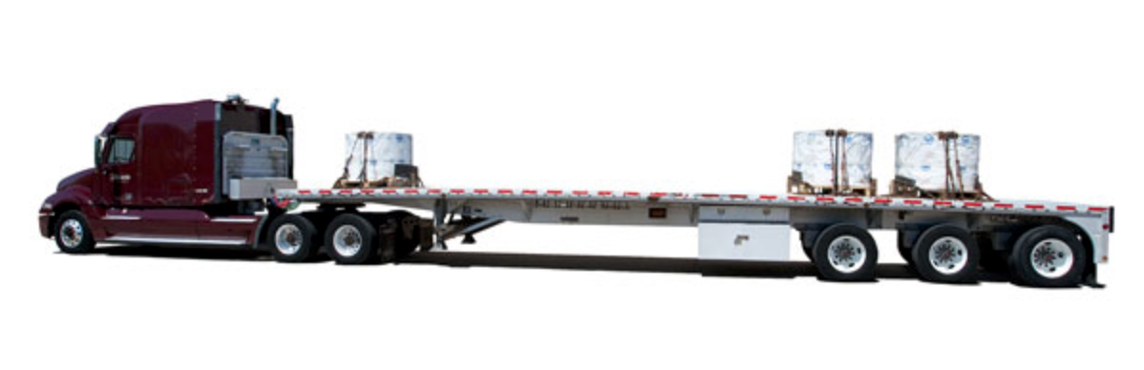

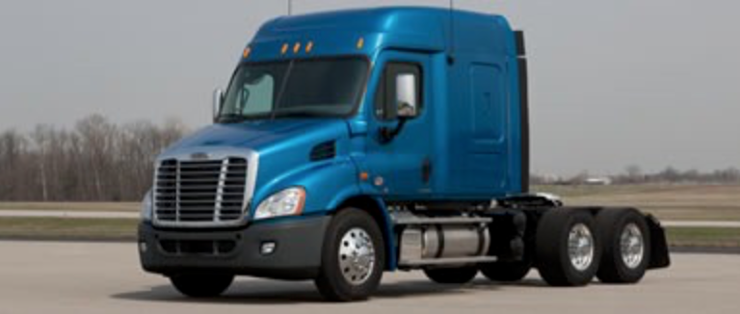
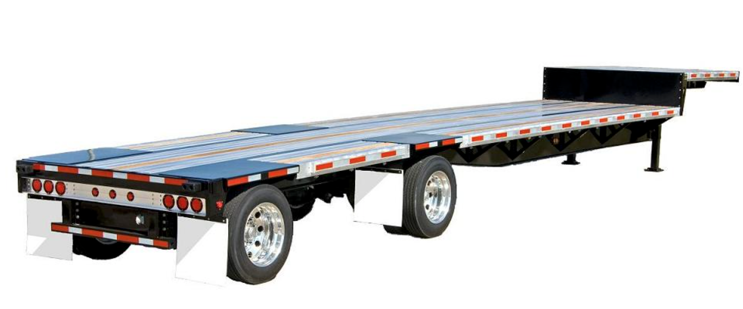
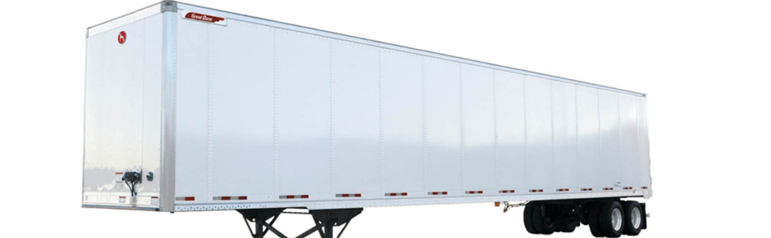
What Kinds Of Loads Do We Offer
Flat Bed
Reefer
Power Only
Step Deck
53” Dry Van

Slide 7

Hinton Dispatching and Associates
Direct Line: (757) 515-1684
E-mail: info@Hintondispatchingandtraining.com
Website: https://www.Hintondispatchingandtraining.com/
Don’t Wait, Call Us Today!!

